Slide 1
Intersectionality of Race and Sport: Identity and Race Based Stress in Division I College Student-Athletes
Brittany L. Collins
University of Cincinnati
Black Student-Athlete Summit
University of Texas, Austin
January 8, 2020

Slide 2
INTRODUCTION
Third Year Doctoral Student in Counselor Education and Supervision, Multicultural and Social Justice Cognate
Mental Health College Counselor, University of Cincinnati Sports Medicine Department, University of Dayton College Counseling Center
Owner of Developing Me! Counseling, & Consulting, LLC
National Certified Counselor (NCC)
Licensed Professional Counselor (LPC)
Master’s in Clinical and Mental Health Counseling, University of Dayton
Master’s in Coaching Education/Athletic Administration, Ohio University
Bachelor’s in Sport Management, Ohio University
Former Division I Women’s Basketball Player at Ohio University

Slide 3
GOAL
To create a space to facilitate discussion on the Intersectionality of multiple identities and Identity and Race Based Stress in Division I Black College Student-Athletes

Slide 4
OBJECTIVE
Increase awareness of the effects of having multiple identities and the causes of Identity and Race Based Stress in Division I Black College Student-Athletes.

Slide 5
COLLEGE STUDENT STRESS
61%..... of college students seeking counseling who report Anxiety
Other concerns include:
Depression
49%
Stress
45%
Family Issues
31%
Academic Performance
28%
Relationship Problems
27%

Slide 6
COLLEGE STUDENT-ATHLETE STRESS
Researchers highlight how athletic participation in and of itself can create additional stressors that other college students do not experience (Wilson & Pritchard, 2005)
Notes:
Although athletic participation can serve as a way to cope with stress…

Slide 7
COLLEGE STUDENT-ATHLETE STRESS
“College athletes are known to encounter unique stress factors that the general student population does not always face. Because of this, student-athletes can be at a higher risk of anxiety and depression.”
(Perry, 2019)
Perry, J. (2019) Retrieved from: https://an.athletenetwork.com/blog/dealing-with-stress-as-a-college-athlete

Slide 8
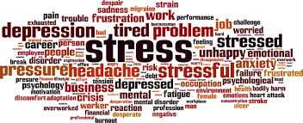
BLACK STUDENT-ATHLETE STRESS
Black student-athletes have additional stressors that often go unnoticed which lead to greater stress

Slide 9
INTERSECTIONALITY AND INTEGRATION
What is not widely talked about throughout the NCAA and Athletic Departments when discussing Mental Health Best Practices is how Race and the intersection of having multiple identities affects student-athlete wellness.
Notes:
Have we taken into consideration how other identities affect student-athletes?

Slide 10
Racial Identity
Currently mental health best practices focus on two identities:
STUDENT-ATHLETE

Slide 11
RACIAL IDENTITY
Race is not often considered when thinking about Stress.
Yet it is apparent throughout history, politics, news and media.

Slide 12
COLORBLINDNESS EXAMPLE
When I see you, I don’t see color. I just see a human being
All Lives Matter-The phrase All Lives Matter came as a response to Black Lives Matter and was criticized for dismissing and misunderstanding the overall message of Black Lives Matter (Carney, 2016).

Slide 13
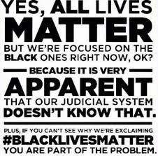
RACIAL IDENTITY
#BlackLivesMatter
Notes:
The Black Lives Matter movement began in 2013 with the use of #BlackLivesMatter on social media after the acquittal of George Zimmerman in the shooting death of Trayvon Martin, an African-American teen in February of 2012 (Lebron, 2017; Taylor, 2016). Overall, both phrases represent how race still matters greatly throughout society and how identifying as a black and/or African-American in the United States can lead to the unfortunate death for some and stress to most (Lebron, 2017).

Slide 14
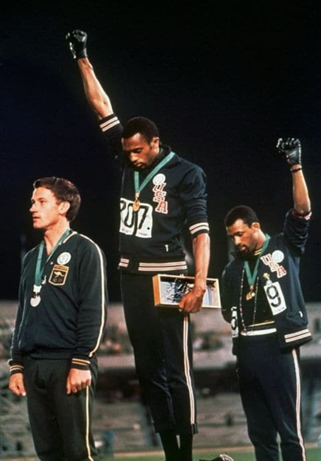
RACIAL IDENTITY
During their medal ceremony in the Olympic Stadium in Mexico City on October 16, 1968, African-American athletes Tommie Smith and John Carlos each raised a black-gloved fist during the playing of the US national anthem, "The Star-Spangled Banner".
Notes:
Used the athletic identity, seen as a position of power and privilege, to stand for racial injustice

Slide 15
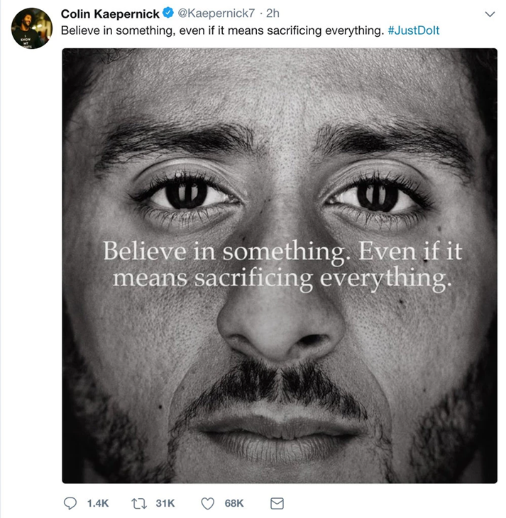
RACIAL IDENTITY
During the 49ers' third preseason game in 2016, Kaepernick began to sit during the playing of the U.S. national anthem prior to games, rather than stand as is customary, as a protest against racial injustice and systematic oppression in the country.
Notes:
Used the athletic identity, seen as a position of power and privilege, to stand for racial injustice

Slide 16
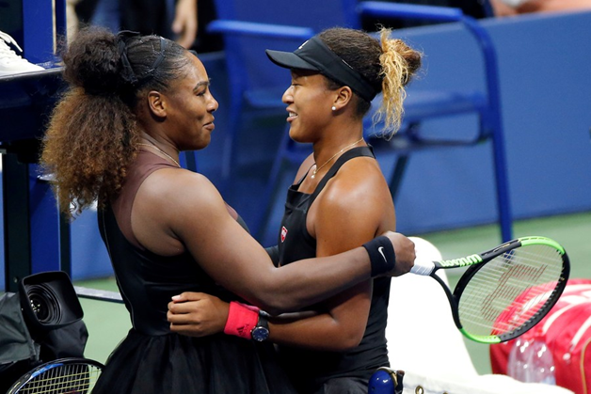
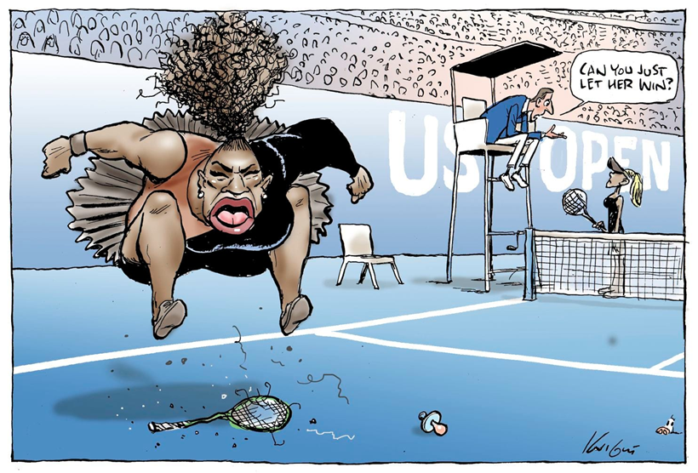
RACIAL IDENTITY
Naomi Osaka defeated legendary tennis star Serena Williams to become the first Grand Slam singles champion.
Notes:
Putting Women of Color against each other and Depicted as the anger black woman and aggressive

Slide 17
BLACK COLLEGE STUDENT-ATHLETE STRESS
Dr. Ryan Sutton (2017) reported that, “research has shown that the impact of racial trauma increases depression, anxiety and even PTSD.” (Sutton, 2017)
Notes:
Stigma of Mental Health and Student-Athletes: The Need to Be seen as Strong, Not Weak
Stigma of Mental Health in the Black Community
The Need to Be seen as Strong, Not Weak

Slide 19
IDENTITY RACE-BASED STRESS
Throughout literature racialized stress is referred in several different ways including:
Race-related stress, Race-based stress, Identity race-based stress, and Race based traumatic stress.

Slide 20
BLACK COLLEGE STUDENT-ATHLETE STRESS
Environment
Identifying as a Black College Student-Athlete attending a PWI:
Adjusting to racial climate and negotiating their identities of being Black and an athlete on a PWI campus (Anthony & Swank, 2018)
Black college student-athletes often receive positive reinforcement for athlete performance, and are viewed as being on campus solely for athletics (Anthony & Swank, 2018)
Notes:
Enviornment
Stigma of Mental Health and Student-Athletes: The Need to Be seen as Strong, Not Weak
Stigma of Mental Health in the Black Community
The Need to Be seen as Strong, Not Weak

Slide 21
BLACK COLLEGE STUDENT-ATHLETE STRESS
Family and Community Pressure
Added pressure and overvaluing of athletics within family, and Black community due to financial gains by playing professionally and funding a college education (Anthony & Swank, 2018; Bimper & Harrison, 2011)
Notes:
Stigma of Mental Health and Student-Athletes: The Need to Be seen as Strong, Not Weak
Stigma of Mental Health in the Black Community
The Need to Be seen as Strong, Not Weak

Slide 22
IDENTITY DEVELOPMENT IN BLACK COLLEGE STUDENT-ATHLETES
Integration of all cultural identities is the healthier and more favorable acculturation process (Tang & Bashir, 2012)

Slide 23
IDENTITY RACE-BASED STRESS
Robert T. Carter's (2007) theory of Race-based traumatic stress indicates that individuals of color often generate responses similar to post-traumatic stress when they have experience racially charged discrimination as traumatic (Carter, 2016).
Notes:
Fight, Flight, or Freeze Response

Slide 24
IDENTITY RACE-BASED STRESS
Carter (2007) defines Race-based traumatic stress as “the traumatic response to stress following a racial encounter. Race-based traumatic stress combines theories of stress, trauma and race-based discrimination to describe a particular response to negative racial encounters (Carter, 2016)

Slide 25
IDENTITY RACE-BASED STRESS
Harrell (2000) defines race-related stress as “transactions between individuals or groups and their environment that emerge from the dynamics of racism or discrimination, and that are to tax or exceed existing individuals and collective resources or threaten wellbeing.”
(Harrell, 2000)

Slide 26
Language of Identity Race Based Stress
Racism: Prejudice towards people based on their race or ethnicity
Discrimination: Unfavorable or unfair treatment against a person or thing based on group, class, gender, ability, sexual identity, etc.

Slide 27
Language of Identity Race Based Stress
Biased incident: Any activity that intimidates, demeans, mocks, degrades, marginalizes, or threatens individuals or groups based on that individual’s or group’s actual or perceived ethnicity, race, gender, sexual orientation, gender identity, religion, age, and ability (Wessler & Moss, 2001).

Slide 28
Language of Identity Race Based Stress
Micro-aggressions: Everyday verbal, nonverbal, and environmental slights, snubs, or insights whether intentional or unintentional, which communicate hostile, derogatory, or negative messages to target persons solely upon their marginalized group membership.

Slide 29
IDENTITY RACE-BASED STRESS
Student-athletes may enter into a state of identity foreclosure.
This term refers to the closing off of any further role identity exploration in an individual and is typically done to avoid any crisis associated with role conflict (Erikson, 1956; Marcia, 1966).
Notes:
As a Result of a One Sized Fits All Approach, Discrimination, Racism, Microaggressions, lack of Culturally proficient support staff
Left with, Who Am I? Or Who Am I now? Once the Student-Athlete Identity has reached completion

Slide 30
QUOTE
Langston Hughes, a black American poet wrote:
“I want to be a poet, not a negro poet. As if his own racial world were not as interesting as any other world.”

Slide 31
QUOTE
How has race impacted your life on the campus?
“It shocked me because like I'm so used to being around more of my race, I grew up with strictly African Americans and when I got here it kind of like shocked me, because I've never been around this many people with other ethnicities so it took me a while to get used to and it's just, something that I had to do.”

Slide 32
QUOTE
Do you feel like you've reached a point where you adjusted?
“I don't think I will reach that point until it's almost time for me to leave because it's just very different from what I'm used to and most people don't want to get accustomed to things that they are different to and that's kind of how I am right now.”

Slide 33
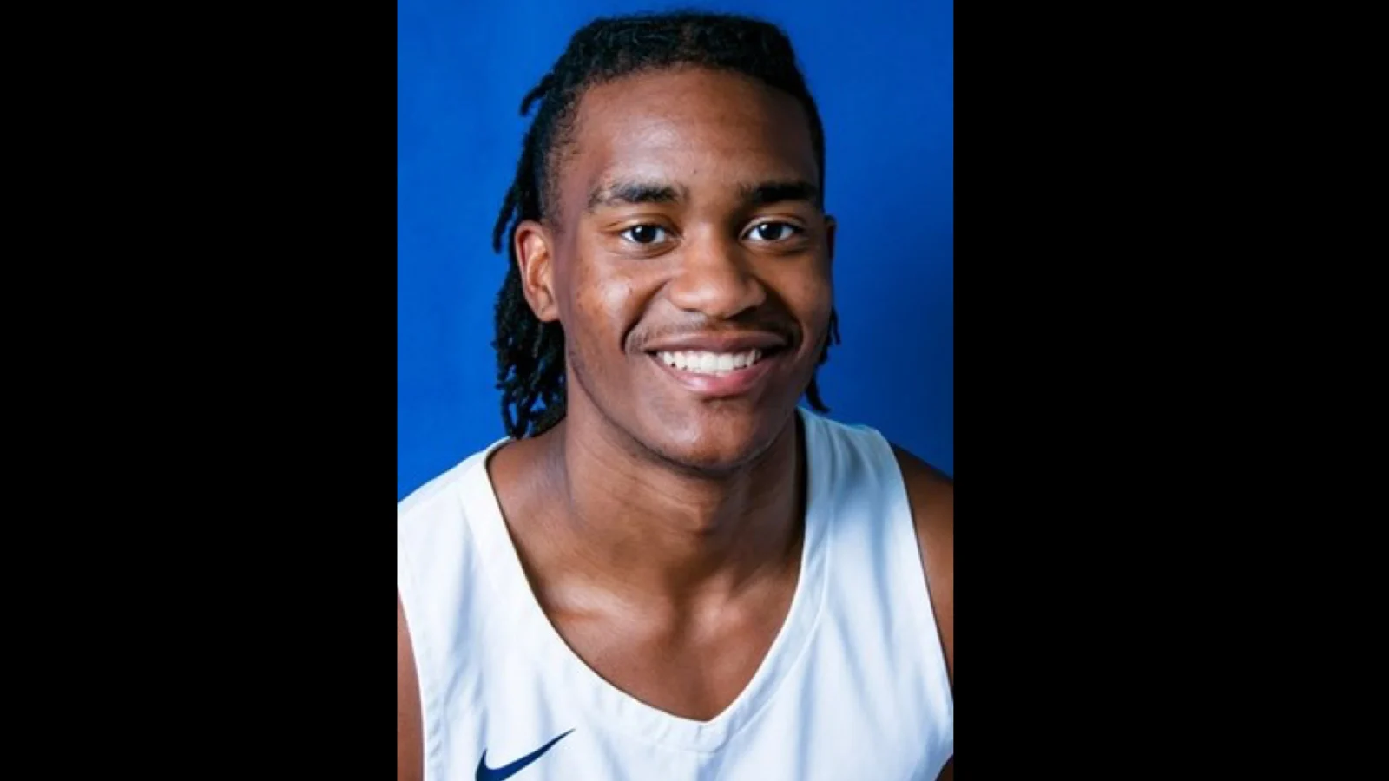
EXAMPLES IN MEDIA

Slide 34
EXAMPLES IN MEDIA
The Penn State fan who sparked a social media storm over a letter he wrote about a Nittany Lions player’s looks has explained his comments were not racial.
David Petersen, a 1966 Penn State graduate the letter about Penn State player Jonathan Sutherland, describing his “shoulder-length dreadlocks look disgusting and are certainly not attractive.”
Read more here: https://www.miamiherald.com/sports/article235921152.html#storylink=cpy

Slide 35
EXAMPLES IN MEDIA
“I would just like to see the coaches get the guys cleaned up and not looking like Florida State and Miami guys.”
“It wasn’t threatening or anything. I was just disgruntled about some of the hairdos that we’re seeing,” he added, “You think of Penn State as a bunch of clean-cut guys. And you do see so many who are clean cut. But the tattoos and the hair — there are a lot of guys with hair coming down their backs and it just looks awful. And it’s the same for the NFL and NBA, too.”
Read more here: https://www.pennlive.com/pennstatefootball/2019/10/jonathan-sutherland-posts-statement-in-response-to-penn-state-fans-letter-about-his-dreadlocks.html

Slide 36
CONSIDERATIONS
More research is needed to explore the effects of identity and the intersectionality of Race and Sport on Black Student-Athlete Wellness
Future research is also needed to explore the effects of identity and the intersectionality of Race, Gender, and Sport on Black Student-Athlete Wellness

Slide 37
CONSIDERATIONS
Cultural Competence vs Cultural Proficiency need to be discussed and explored more frequently
Adequate trainings to ensure that support staff are properly trained and prepared to assist with and are sensitive to Black College student-athletes ongoing needs and growing concerns

Slide 38
CONSIDERATIONS
Coakley (2017) states that Black college student-athletes have little to no support due to faculty, administrators, and other support staff not knowing much about the experiences of Black college student-athletes (Coakley, 2017).

Slide 39
CONSIDERATIONS
There is a need for more women and minorities in supporting roles and leadership throughout the NCAA
Notes:
Revisiting Title IX Initiatives and who and what it serves

Slide 40
CONSIDERATIONS
Big East commissioner Val Ackerman noted that, "As the rosters of college sports programs have morphed over time to include more female and ethnically diverse student-athletes, our leadership should be mirroring those changes so that we can better understand and address student-athlete needs, which is a core NCAA objective.”
https://www.espn.com/mens-college basketball/story/_/id/22602600/the-ncaa-continues-struggle-2017-racial-gender-report-card

Slide 41
CONSIDERATIONS
Coakley (2017), “Black female College Student-Athletes see few women of color in positions of power and authority in their schools and athletic departments, so they might not feel fully included in either sphere” (Coakley, 2017, p.475).

Slide 42
CONSIDERATIONS
Ecological Perspective
B=f (P,E)
Understanding Person (Black Student-Athlete) and Environment (PWI) and how it effects or impacts Behavior and Wellness
Notes:
Person-Centered meaning understanding the person as a whole part. Not just one portion or two identities.

Slide 43
CONSIDERATIONS
Provides specific awareness through training, which enables support staff and those in student-athlete development to understand the “big picture” about forces that impact Black College Student-athletes
(Tang & Bashir, 2012)
Reviews the multifaceted nature of cultural identity, the intersectionality of multiple roles and life spaces, and the interaction of individuals with the environment
(Tang & Bashir, 2012)
Notes:
Gives a different Lens…Narrative perspective…Understanding the story

Slide 44
REFERENCES
Anthony, C. E., & Swank, J. M. (2018). Black college student-athletes: Examining the intersection of gender, and racial identity and athletic identity. Journal for the Study of Sports and Athletes in Education, 12(3), 179-199. doi:10.1080/19357397.2018.1525133
Belgrave, F. Z., & Javier, S.J. (2016) “I’m Not Just Black!”: Exploring Intersections of Identity. Retrieved from https://psychologybenefits.org/2016/09/08/im-not-just-black-exploring-intersections-of-identity/
Bimper, A.Y., Harrison, L., & Clark, L. (2012). Diamonds in the rough: Examining a case of successful Black male student athletes in college sport. The Journal of Black Psychology, 1-24.
Carter, R. T. (2016). "Racism and Psychological and Emotional Injury". The Counseling Psychologist. 35 (1): 13–105. doi:10.1177/0011000006292033.
Carter, R. T., Forsyth, J. M., Mazzula, S. L., & Williams, B. (2005). Racial discrimination and race-based traumatic stress: An exploratory investigation. Handbook of racial-cultural psychology and counseling :Training and practice, 2, 447-476.
Carter, R. T. (2006). Race-based traumatic stress. Psychiatric Times, 23(14), 37-37.https://www.psychiatrictimes.com/articles/race-based-traumatic-stress

Slide 45
REFERENCES
Coakley, J. J., & Pike, E. (2014). Sports in society: Issues and controversies.
Cook, E. P., & Ohio Library and Information Network. (2012). Understanding people in context: The ecological perspective in counseling. Alexandria, VA: American Counseling Association.
Erikson, E. H. (1956). The problem of ego identity. J. Am. Psychoanalyt. Assoc. 4: 56–122.
Marcia, J. E. (1966). Development and validation of ego identity status. J. Personal. Soc. Psychol. 3: 551–558.
Oxford English Dictionary (2019) Definition of Intersectionality. Retrieved from https://en.oxforddictionaries.com/definition/intersectionality
Smith, S. (2013). Black feminism and intersectionality. International Socialist Review, 91(11).
Tang, M. & Bashir, H. (2012). Diversity From the Ecological Perspective. Understanding people in context: The ecological perspective in counseling. Alexandria, VA: American Counseling Association.
McClain, S., Beasley, S. T., Jones, B., Awosogba, O., Jackson, S., & Cokley, K. (2016). An examination of the impact of racial and ethnic identity, impostor feelings, and minority status stress on the mental health of black college students. Journal of Multicultural Counseling and Development, 44(2), 101-117. doi:10.1002/jmcd.12040

Slide 46
REFERENCES
Retrieved from American Psychological Association (2017): https://www.apa.org/monitor/2017/09/numbers
Retrieved from College sports racial and gender report card (Richard Lapchick, February 28, 2018) https://www.espn.com/mens-college basketball/story/_/id/22602600/the-ncaa-continues-struggle-2017-racial-gender-report-card
Retrieved from NCAA Demographics Database (December 2018). http://www.ncaa.org/about/resources/research/ncaa-demographics-database
Retrieved from NCAA Race and Gender Demographics Database (October 2019) http://www.ncaa.org/about/resources/research/diversity-research
https://www.miamiherald.com/sports/article235921152.html#storylink=cpy

Slide 47
Questions
collinby@mail.uc.edu
Brittany@developingmellc.com

