Slide 1
Intersectionality of Race and Sport: Identity Based Stress in Division I College Student-Athletes
Brittany L. Collins
University of Cincinnati
N4A Midwest Regional Conference
October 11, 2019

Slide 2
INTRODUCTION
Third Year Doctoral Student in Counselor Education, Multicultural and Social Justice Cognate
Mental Health College Counselor, University of Cincinnati Sports Medicine Department, University of Dayton College Counseling Center
Owner of Developing Me! Coaching, Counseling, & Therapy, LLC
National Certified Counselor (NCC)
Licensed Professional Counselor (LPC)
Chemical Dependency Counselor Assistant (CDCA)
Master’s in Clinical and Mental Health Counseling, University of Dayton
Master’s in Coaching Education/Athletic Administration, Ohio University
Bachelor’s in Sport Management, Ohio University
Former Division I Women’s Basketball Player at Ohio University

Slide 3
OUTLINE
Brief Introduction
Goals and Objectives
Overview of College Student and Student-Athlete Stress
Overview of Black College Student-Athletes Stress
Overview of Racial Identity
Overview of Environment, PWI vs HBCU
Overview of Statistics on Black Student-Athletes at PWI’s vs HBCU’s
Cultural Identity Development
Overview and Language of Intersectionality
Overview and Language of Identity Race Based Stress
Examples in Media
Considerations

Slide 4
GOALS
To create a space to facilitate discussion on Intersectionality and Identity Race Based Stress in
Division I Black College Student-Athletes

Slide 5
OBJECTIVES
Define and understand the language and impact of Intersectionality and Cultural Identity Development
Enhance awareness of Identity Race Based Stress in Division I Black College Student-Athletes attending Predominately White Institutions (PWIs)

Slide 6
COLLEGE STUDENT STRESS
Stress on campus
College and university counseling centers are seeing a rise in the number of students seeking help
American Psychological Association (2017): https://www.apa.org/monitor/2017/09/numbers

Slide 7
COLLEGE STUDENT STRESS
61%.....the percentage of college students seeking counseling who report Anxiety
Other concerns include:
Depression (49 percent)
Stress (45 percent)
Family Issues (31 percent)
Academic Performance (28 percent)
Relationship Problems (27 percent).1

Slide 8
COLLEGE STUDENT STRESS
2018 ABC NEWS Reported
3 out of 4 college students say they're stressed, many report suicidal thoughts
https://abcnews.go.com/GMA/college-students-stressed-report-suicidal-thoughts-study/story?id=57646236
Notes:
Every college student that I meet with I must assess suicidality

Slide 9
COLLEGE STUDENT-ATHLETE STRESS
Although athletic participation can serve as a way to cope with stress….
Researchers highlight how athletic participation in and of itself can create additional stressors that other college students do not experience (Wilson & Pritchard, 2005).

Slide 10
COLLEGE STUDENT-ATHLETE STRESS
“College athletes are known to encounter unique stress factors that the general student population does not always face. Because of this, student-athletes can be at a higher risk of anxiety and depression.”
(Perry, 2019)
Perry, J. (2019) Retrieved from: https://an.athletenetwork.com/blog/dealing-with-stress-as-a-college-athlete

Slide 11
COLLEGE STUDENT-ATHLETE STRESS
Adjustment
Expectations
(Coaches, Professors, Teammates, Family, Friends, Self)
Time Management
Lack of Balance
Lack of Sleep, Exhaustion
Injury
Lack of Relationships
Too Many Demands
Anxiety, Irritation, Fear
Social Media
Notes:
Throughout Team Talk Sessions student-athletes have expressed stress for a number of reasons including

Slide 12
COLLEGE STUDENT-ATHLETE STRESS
Overall, what we can see is that the intersection of being both a student and an athlete shows adverse effects on student-athlete wellness due to trying to balance the two identities.
Notes:
Have we taken into consideration how other identities affect student-athletes?

Slide 13
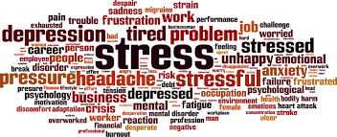
BLACK COLLEGE STUDENT-ATHLETE STRESS
Black student-athletes have additional stressors that often go unnoticed.

Slide 14
RACIAL IDENTITY
The NCAA Demographics Database provides Racial and Ethnicity Category Definitions
Black is defined as: A person having origins in any of the Black racial groups of Africa
(except those of Hispanic origin).

Slide 15
RACIAL IDENTITY
Race is not often considered when thinking about Stress.
Yet it is apparent throughout history, politics, news and media.

Slide 16
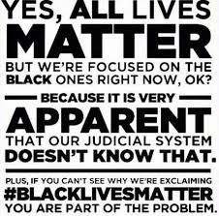
RACIAL IDENTITY
#BlackLivesMatter
#AllLivesMatter
#RaceStillMatters
Notes:
The Black Lives Matter movement began in 2013 with the use of #BlackLivesMatter on social media after the acquittal of George Zimmerman in the shooting death of Trayvon Martin, an African-American teen in February of 2012 (Lebron, 2017; Taylor, 2016). Overall, both phrases represent how race still matters greatly throughout society and how identifying as a black and/or African-American in the United States can lead to the unfortunate death for some and stress to most (Lebron, 2017).

Slide 17
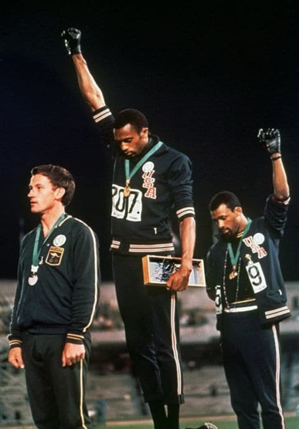
RACIAL IDENTITY
During their medal ceremony in the Olympic Stadium in Mexico City on October 16, 1968, African-American athletes Tommie Smith and John Carlos each raised a black-gloved fist during the playing of the US national anthem, "The Star-Spangled Banner".
Notes:
Used the athletic identity, seen as a position of power and privilege, to stand for racial injustice

Slide 18
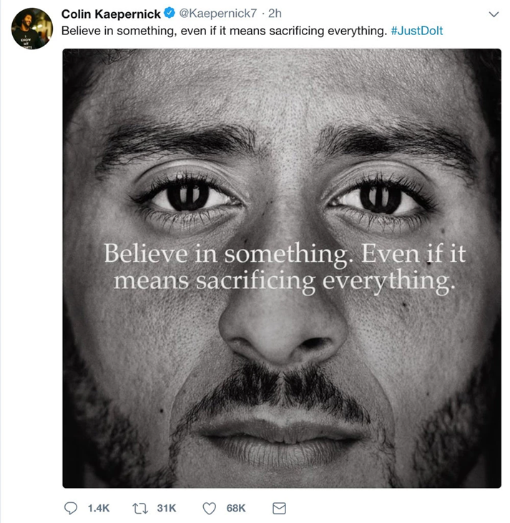
RACIAL IDENTITY
During the 49ers' third preseason game in 2016, Kaepernick began to sit during the playing of the U.S. national anthem prior to games, rather than stand as is customary, as a protest against racial injustice and systematic oppression in the country.
Notes:
Used the athletic identity, seen as a position of power and privilege, to stand for racial injustice

Slide 19
RACIAL IDENTITY
Naomi Osaka defeated legendary tennis star Serena Williams to become the first Grand Slam singles champion.
But Osaka’s victory was soon overshadowed. After chair umpire Carlos Ramos cited Williams for three code violations during the second set of the loss — for receiving coaching during a match, breaking her racket and calling Ramos a “thief” — Williams accused him of sexism.
Notes:
Putting Women of Color against each other and Depicted as the anger black woman and aggressive

Slide 20
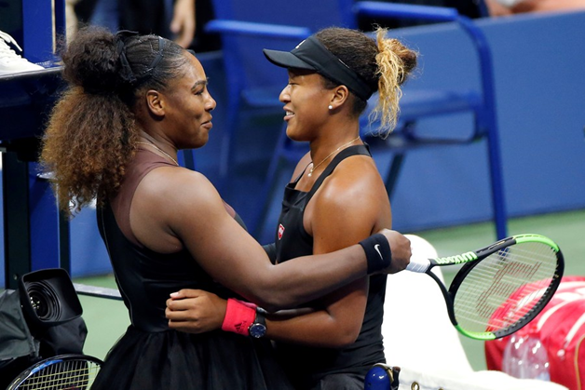
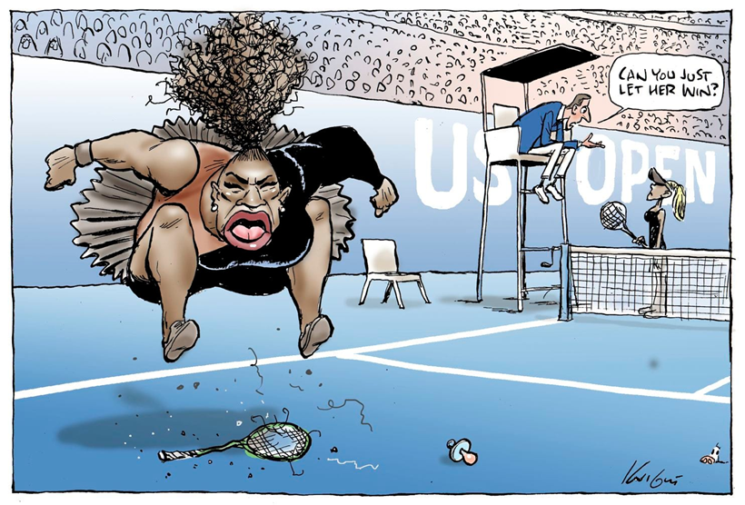
RACIAL IDENTITY
Notes:
Putting Women of Color against each other and Depicted as the anger black woman and aggressive
Does anyone what to share how seeing these images now, or experiencing the event at the time, made or makes them feel?

Slide 21
BLACK COLLEGE STUDENT-ATHLETE STRESS
Dr. Ryan Sutton (2017) states, “Race impacts what mental health disorders look like and how they’re diagnosed.” (Sutton, 2017)
Adding that, “research has shown that the impact of racial trauma increases depression, anxiety and even PTSD.” (Sutton, 2017)
Notes:
Misdiagnosis: Oppositional Defiant Disorder, Conduct Disorder
Stigma of Mental Health and Student-Athletes: The Need to Be seen as Strong, Not Weak
Stigma of Mental Health in the Black Community
The Need to Be seen as Strong, Not Weak

Slide 22
BLACK COLLEGE STUDENT-ATHLETE STRESS
Identifying as a Black College Student-Athlete attending a PWI:
Adjusting to racial climate and negotiating their identities of being Black and an athlete on a PWI campus (Anthony & Swank, 2018)
Black college student-athletes often receive positive reinforcement for athlete performance, and are viewed as being on campus solely for athletics (Anthony & Swank, 2018)
Notes:
Can be very similar to the experiences of International Student-Athletes
Stigma of Mental Health and Student-Athletes: The Need to Be seen as Strong, Not Weak
Stigma of Mental Health in the Black Community
The Need to Be seen as Strong, Not Weak

Slide 23
BLACK COLLEGE STUDENT-ATHLETE STRESS
Identifying as a Black College Student-Athlete attending a PWI:
Added pressure and overvaluing of athletics within family, and Black community due to financial gains by playing professionally and funding a college education
(Anthony & Swank, 2018; Bimper & Harrison, 2011)
Notes:
Stigma of Mental Health and Student-Athletes: The Need to Be seen as Strong, Not Weak
Stigma of Mental Health in the Black Community
The Need to Be seen as Strong, Not Weak

Slide 24
BLACK COLLEGE STUDENT-ATHLETE STRESS
Identifying as a Black College Student-Athlete attending a PWI:
Marginalized population: Black college athletes experience marginalization based on race and the student-athlete role (Anthony & Swank, 2018; Stone et al, 2012)
Imposter Syndrome
Notes:
Stigma of Mental Health and Student-Athletes: The Need to Be seen as Strong, Not Weak
Stigma of Mental Health in the Black Community
The Need to Be seen as Strong, Not Weak

Slide 25
ENVIORNMENT
Predominately White Institutions (PWIs): used to describe institutions of higher learning in which Whites account for 50% or greater of the student enrollment.
Historically Black College and Universities (HBCUs): are institutions of higher education in the United States that were established before the Civil Rights Act of 1964 with the intention of primarily serving the educational needs of the African-American community.

Slide 26
STATISTICS ON BLACK STUDENT-ATHLETES
According to the NCAA Demographics Database:
In 2018 Black college student-athletes represented 18% of Non-HBCU or PW Division I Institutions
Retrieved from NCAA Demographics Database (December, 2018). http://www.ncaa.org/about/resources/research/ncaa-demographics-database

Slide 27
STATISTICS ON BLACK STUDENT-ATHLETES
According to the NCAA Demographics Database:
In 2018 Black college student-athletes represented 78% of Division I HBCU Institutions
Retrieved from NCAA Demographics Database (December, 2018). http://www.ncaa.org/about/resources/research/ncaa-demographics-database

Slide 28
QUOTE
In a recent Article written by Jemele Hill for the Atlantic, a quote was highlighted on Black athletes attending HBCU’s vs. PWI’s
“Navigating a predominantly white campus as a black student can feel isolating, even for athletes.”-Jemele Hill
“Going to a school where most of the people are the same color as you, it’s almost like you can let your guard down a little bit,” he told me. “You don’t have to pretend to be somebody else. You don’t have to dress this way or do things this way. It’s like, ‘I know you. We have the same kind of struggles. We can relate.’ It’s almost like you’re back at home in your neighborhood.”- Davon Dillard is a basketball player who transferred to Shaw University after Oklahoma State dismissed him for disciplinary reasons.”

Slide 29
QUOTE
How has race impacted your life on the campus?
“It shocked me because like I'm so used to being around more of my race, I grew up with strictly African Americans and when I got here it kind of like shocked me, because I've never been around this many people with other ethnicities so it took me a while to get used to and it's just, something that I had to do.”

Slide 30
QUOTE
Do you feel like you've reached a point where you adjusted?
“I don't think I will reach that point until it's almost time for me to leave because it's just very different from what I'm used to and most people don't want to get accustomed to things that they are different to and that's kind of how I am right now.”

Slide 31
CULTURAL IDENTITY DEVELOPMENT
Researchers have tried to understand cultural identity development from various perspectives. (Tang & Bashir, 2012)
Just like human development, cultural identity development is complex and does not happen in a linear manner. (Tang & Bashir, 2012; Pederson, 2000)

Slide 32
IDENTITY DEVELOPMENT IN BLACK COLLEGE STUDENT-ATHLETES
Acculturation: is a process by which individuals negotiate and adapt their experiences of being in two cultures. (Tang & Bashir, 2012)
Berry (1980) stated that for the group caught between two cultures, two issues need to be resolved. (Tang & Bashir, 2012)

Slide 33
IDENTITY DEVELOPMENT IN BLACK COLLEGE STUDENT-ATHLETES
One: Is the extent to which the individual or group members want to conserve their own cultural background as opposed to giving up their cultural traditions. (Tang & Bashir, 2012)
The Other: Is the extent to which the individual or group members want to interact with members of other groups in the larger society as opposed to turning away from these other groups.

Slide 34
IDENTITY DEVELOPMENT IN BLACK COLLEGE STUDENT-ATHLETES
Berry’s (1980, 2003) Acculturation model proposed two intersecting dimensions that an individual would choose once they left the original cultural context to live in the new culture (Tang & Bashir, 2012)

Slide 35
IDENTITY DEVELOPMENT IN BLACK COLLEGE STUDENT-ATHLETES
One dimension is the Acquisition of New Culture (Tang & Bashir, 2012)
The Other is the Retention of the Heritage Culture (Tang & Bashir, 2012)
Integration of both is the healthier and more favorable acculturation process (Tang & Bashir, 2012)

Slide 36
IDENTITY DEVELOPMENT IN BLACK COLLEGE STUDENT-ATHLETES
Berry’s (1980, 2003) Acculturation model also highlights a potential category: Marginalization (Tang & Bashir, 2012)
This category is low on acquiring new culture and low on retaining traditional culture (Tang & Bashir, 2012)
Notes:
Confusion, Vulnerability, Stress

Slide 37
IDENTITY RACE-BASED STRESS
Student-athletes may enter into a state of identity foreclosure.
This term refers to the closing off of any further role identity exploration in an individual and is typically done to avoid any crisis associated with role conflict (Erikson, 1956; Marcia, 1966).

Slide 38
INTERSECTIONALITY
Black legal scholar Kimberlé Crenshaw coined the term “intersectionality” in her insightful 1989 essay, “Demarginalizing the Intersection of Race and Sex: A Black Feminist Critique of Antidiscrimination Doctrine, Feminist Theory and Antiracist Politics.” (Smith, 2013)
“The concept of intersectionality is not an abstract notion, but a description of the way multiple oppressions are experienced.” (Smith, 2013)

Slide 39
INTERSECTIONALITY
The Oxford English dictionary defines Intersectionality as “the interconnected nature of social categorizations such as race, class, and gender as they apply to a given individual or group, regarded as creating overlapping and interdependent systems of discrimination or disadvantage.” (Oxford English Dictionary, 2019).

Slide 40
IDENTITY BASED STRESS
Being forced to choose one, or in this case two identities, influences Black College Student-Athlete wellness.

Slide 41
IDENTITY RACE-BASED STRESS
Throughout the literature racialized stress is referred in several different ways including:
Race-related stress, Race-based stress, Identity race-based stress, and Race based traumatic stress.

Slide 42
IDENTITY RACE-BASED STRESS
Robert T. Carter's (2007) theory of Race-based traumatic stress indicates that individuals of color often generate responses similar to post-traumatic stress when they have experience racially charged discrimination as traumatic (Carter, 2016).
Notes:
Fight, Flight, or Freeze Response

Slide 43
IDENTITY RACE-BASED STRESS
Carter (2007) defines Race-based traumatic stress as “the traumatic response to stress following a racial encounter. Race-based traumatic stress combines theories of stress, trauma and race-based discrimination to describe a particular response to negative racial encounters (Carter, 2016)

Slide 44
IDENTITY RACE-BASED STRESS
The University of Illinois Urbana-Champaign Counseling Center (2015) refers to Race-related stress as psychological distress associated with experiences of racism, discrimination, and microaggressions that minority, generally black and/or African American individuals, experience. (University of Illinois Urbana-Champaign Counseling Center, 2015)

Slide 45
IDENTITY RACE-BASED STRESS
Harrell (2000) defines race-related stress as “transactions between individuals or groups and their environment that emerge from the dynamics of racism or discrimination, and that are to tax or exceed existing individuals and collective resources or threaten wellbeing.” (Harrell, 2000)

Slide 46
Language of Identity Race Based Stress
Racism: Prejudice towards people based on their race or ethnicity
Discrimination: Unfavorable or unfair treatment against a person or thing based on group, class, gender, ability, sexual identity, etc.

Slide 47
Language of Identity Race Based Stress
Biased incident: Any activity that intimidates, demeans, mocks, degrades, marginalizes, or threatens individuals or groups based on that individual’s or group’s actual or perceived ethnicity, race, gender, sexual orientation, gender identity, religion, age, and ability (Wessler & Moss, 2001).

Slide 48
Language of Identity Race Based Stress
Micro-aggressions: Everyday verbal, nonverbal, and environmental slights, snubs, or insights whether intentional or unintentional, which communicate hostile, derogatory, or negative messages to target persons solely upon their marginalized group membership.

Slide 49
MICROAGRESSIONS

Slide 50
COLORBLINDNESS EXAMPLE
“I don’t see you as Black. I just see you as a regular person.”
All Lives Matter-The phrase All Lives Matter came as a response to Black Lives Matter and was criticized for dismissing and misunderstanding the overall message of Black Lives Matter (Carney, 2016).

Slide 51
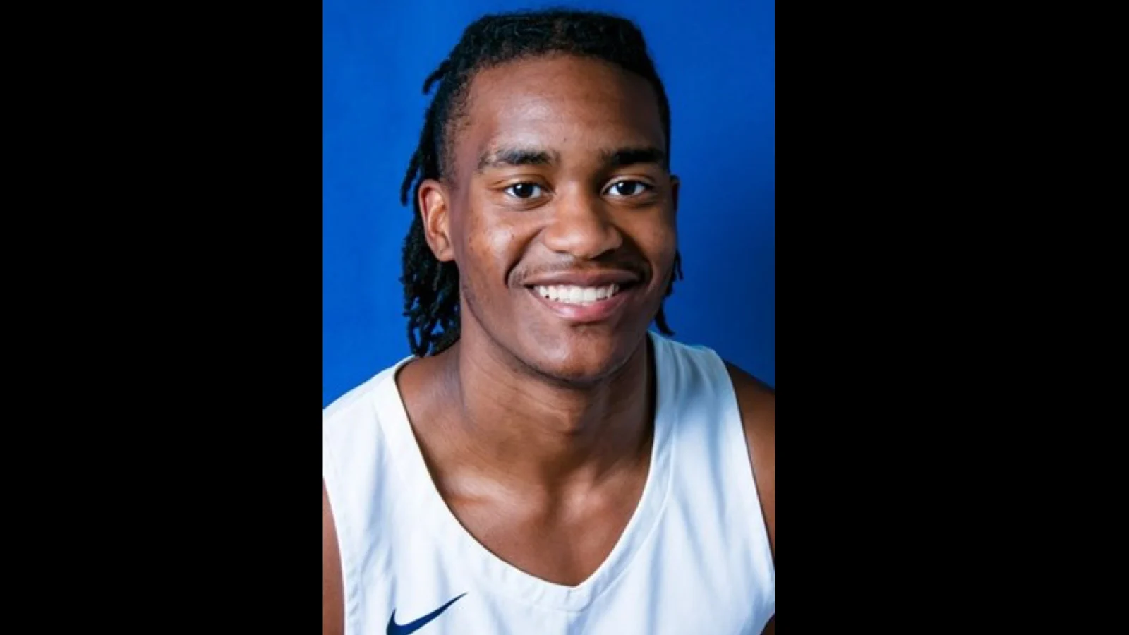
EXAMPLES IN MEDIA

Slide 52
EXAMPLES IN MEDIA
The Penn State fan who sparked a social media storm over a letter he wrote about a Nittany Lions player’s looks has explained his comments were not racial.
David Petersen, a 1966 Penn State graduate the letter about Penn State player Jonathan Sutherland, describing his “shoulder-length dreadlocks look disgusting and are certainly not attractive.”
Read more here: https://www.miamiherald.com/sports/article235921152.html#storylink=cpy

Slide 53
EXAMPLES IN MEDIA
“I would just like to see the coaches get the guys cleaned up and not looking like Florida State and Miami guys.”
“It wasn’t threatening or anything. I was just disgruntled about some of the hairdos that we’re seeing,” he added, “You think of Penn State as a bunch of clean-cut guys. And you do see so many who are clean cut. But the tattoos and the hair — there are a lot of guys with hair coming down their backs and it just looks awful. And it’s the same for the NFL and NBA, too.”
Read more here: https://www.pennlive.com/pennstatefootball/2019/10/jonathan-sutherland-posts-statement-in-response-to-penn-state-fans-letter-about-his-dreadlocks.html

Slide 54
EXAMPLES IN MEDIA
Penn State football coach James Franklin addressed the letter stating:
"The football I know brings people together."
Read more here: https://www.miamiherald.com/sports/article235921152.html#storylink=cpy

Slide 55
EXAMPLES IN MEDIA
Sutherland posted the following response on Twitter Tuesday:
“Although the message was indeed rude, ignorant, and judging, I’ve taken no personal offense to it because personally, I must respect you as a person before I respect your opinion.”
"At the end of the day, without an apology needed, I forgive this individual because I’m nowhere close to being perfect and I expect God to forgive me for all the wrong I’ve done in my life.”
Read more here: https://www.pennlive.com/pennstatefootball/2019/10/jonathan-sutherland-posts-statement-in-response-to-penn-state-fans-letter-about-his-dreadlocks.html

Slide 56
EXAMPLES IN MEDIA
Sutherland posted the following response on Twitter Tuesday:
Let this be one of the many examples to us that in the year 2019, people of different cultures, religions, and ethnicities are still being discriminated against and it needs to stop.
“Don’t be scared to be different!!”
Read more here: https://www.pennlive.com/pennstatefootball/2019/10/jonathan-sutherland-posts-statement-in-response-to-penn-state-fans-letter-about-his-dreadlocks.html

Slide 57
CONSIDERATIONS
More research is needed to explore the effects of identity and the intersectionality of Race and Sport on Black Student-Athlete Wellness
Future research is also needed to explore the effects of identity and the intersectionality of Race, Gender, and Sport on Black Student-Athlete Wellness

Slide 58
CONSIDERATIONS
Terms such as Diversity and Inclusion and Cultural Competence need to be discussed and explored more frequently
Adequate trainings to ensure that support staff are properly trained and prepared to assist with and are sensitive to Black College student-athletes ongoing needs and growing concerns

Slide 59
CONSIDERATIONS
Coakley (2017) states that Black college student-athletes have little to no support due to faculty, administrators, and other support staff not knowing much about the experiences of Black college student-athletes (Coakley, 2017).

Slide 60
CONSIDERATIONS
There is a need for more women and minorities in supporting roles and leadership throughout NCAA Division I PWI’s

Slide 61
CONSIDERATIONS
Big East commissioner Val Ackerman noted that, "As the rosters of college sports programs have morphed over time to include more female and ethnically diverse student-athletes, our leadership should be mirroring those changes so that we can better understand and address student-athlete needs, which is a core NCAA objective.”
https://www.espn.com/mens-college basketball/story/_/id/22602600/the-ncaa-continues-struggle-2017-racial-gender-report-card

Slide 62
CONSIDERATIONS
Coakley (2017), “Black female College Student-Athletes see few women of color in positions of power and authority in their schools and athletic departments, so they might not feel fully included in either sphere” (Coakley, 2017, p.475).

Slide 63
CONSIDERATIONS
Ecological Perspective
B=f(P,E)
Person-centered approach vs Student-Athlete approach
Being able to recognize signs of symptoms of cultural identity development
Understanding Person (Black Student-Athlete) and Environment (PWI) and how it effects or impacts Behavior
Notes:
Person-Centered meaning understanding the person as a whole part. Not just one portion or two identities.

Slide 64
CONSIDERATIONS
A main assumption of ecological counseling is that behavior results from the ways in which people make meaning of their environment.
There are levels of systems which interact, and within which individuals influence, and are influenced.

Slide 65
CONSIDERATIONS
Provides specific awareness through training, which enables support staff and those in student-athlete development to understand the “big picture” about forces that impact their Black College Student-athletes. (Tang & Bashir, 2012)
Reviews the multifaceted nature of cultural identity, the intersectionality of multiple roles and life spaces, and the interaction of individuals with the environment (Tang & Bashir, 2012)
Notes:
Gives a different Lens…Narrative perspective…Understanding the story

Slide 66
REFERENCES
Anthony, C. E., & Swank, J. M. (2018). Black college student-athletes: Examining the intersection of gender, and racial identity and athletic identity. Journal for the Study of Sports and Athletes in Education, 12(3), 179-199. doi:10.1080/19357397.2018.1525133
Belgrave, F. Z., & Javier, S.J. (2016) “I’m Not Just Black!”: Exploring Intersections of Identity. Retrieved from https://psychologybenefits.org/2016/09/08/im-not-just-black-exploring-intersections-of-identity/
Bimper, A.Y., Harrison, L., & Clark, L. (2012). Diamonds in the rough: Examining a case of successful Black male student athletes in college sport. The Journal of Black Psychology, 1-24.
Carter, R. T. (2016). "Racism and Psychological and Emotional Injury". The Counseling Psychologist. 35 (1): 13–105. doi:10.1177/0011000006292033.
Carter, R. T., Forsyth, J. M., Mazzula, S. L., & Williams, B. (2005). Racial discrimination and race-based traumatic stress: An exploratory investigation. Handbook of racial-cultural psychology and counseling :Training and practice, 2, 447-476.
Carter, R. T. (2006). Race-based traumatic stress. Psychiatric Times, 23(14), 37-37.https://www.psychiatrictimes.com/articles/race-based-traumatic-stress

Slide 67
REFERENCES
Coakley, J. J., & Pike, E. (2014). Sports in society: Issues and controversies.
Cook, E. P., & Ohio Library and Information Network. (2012). Understanding people in context: The ecological perspective in counseling. Alexandria, VA: American Counseling Association.
Erikson, E. H. (1956). The problem of ego identity. J. Am. Psychoanalyt. Assoc. 4: 56–122.
Marcia, J. E. (1966). Development and validation of ego identity status. J. Personal. Soc. Psychol. 3: 551–558.
Oxford English Dictionary (2019) Definition of Intersectionality. Retrieved from https://en.oxforddictionaries.com/definition/intersectionality
Smith, S. (2013). Black feminism and intersectionality. International Socialist Review, 91(11).
Tang, M. & Bashir, H. (2012). Diversity From the Ecological Perspective. Understanding people in context: The ecological perspective in counseling. Alexandria, VA: American Counseling Association.
McClain, S., Beasley, S. T., Jones, B., Awosogba, O., Jackson, S., & Cokley, K. (2016). An examination of the impact of racial and ethnic identity, impostor feelings, and minority status stress on the mental health of black college students. Journal of Multicultural Counseling and Development, 44(2), 101-117. doi:10.1002/jmcd.12040

Slide 68
REFERENCES
Retrieved from American Psychological Association (2017): https://www.apa.org/monitor/2017/09/numbers
Retrieved from College sports racial and gender report card (Richard Lapchick, February 28, 2018) https://www.espn.com/mens-college basketball/story/_/id/22602600/the-ncaa-continues-struggle-2017-racial-gender-report-card
Retrieved from NCAA Demographics Database (December 2018). http://www.ncaa.org/about/resources/research/ncaa-demographics-database
Retrieved from NCAA Race and Gender Demographics Database (October 2019) http://www.ncaa.org/about/resources/research/diversity-research
https://www.miamiherald.com/sports/article235921152.html#storylink=cpy

Slide 69
Questions
collinby@mail.uc.edu
developingmellc@gmail.com

